Slide 1
EEE-318
Control Systems Lab Project
Mobile Manipulator for Automating Delivery of Essentials in a Hospital
Using MATLAB and CoppeliaSim

Slide 2
Objectives
Simulation environment design on Coppeliasim
Choice and design of robot model
Control system algorithm implementation on MATLAB
Mobile robot operation using vision data
Manipulator operation for picking up and placing object

Slide 3
Why MATLAB
Why Coppeliasim
Fast deployment of algorithm using scripts
Libraries for image processing operations
Easy connectivity with simulator software
Research standard for Robotics and Control System applications
Lightweight simulator for robots
Integrated physics engine and kinematics solver
Available robot simulation models
Easy connectivity with MATLAB
Configurable environment

Slide 4
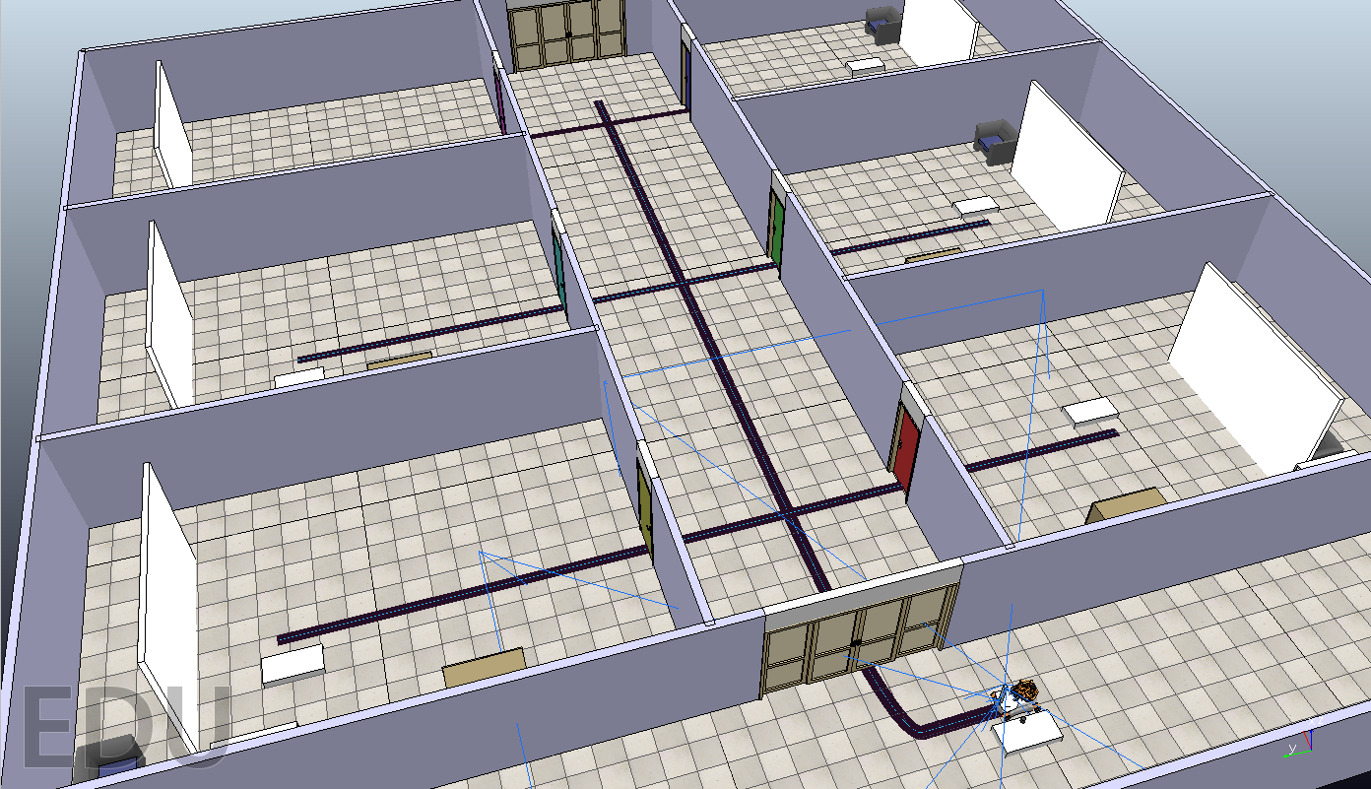
Simulation Environment
Demo Hospital Setup

Slide 5
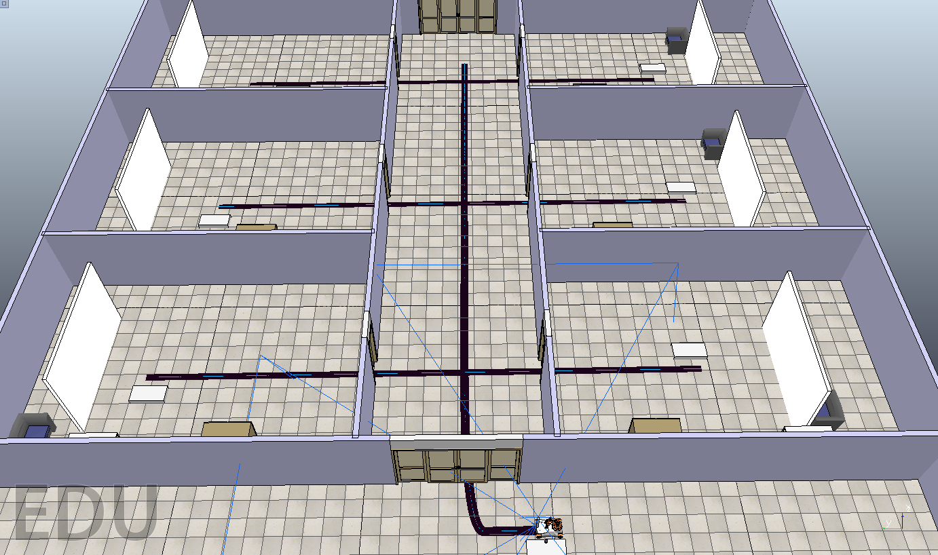
Simulation Environment
Path for the LFR to Follow to Deliver to the Hospital Rooms

Slide 6
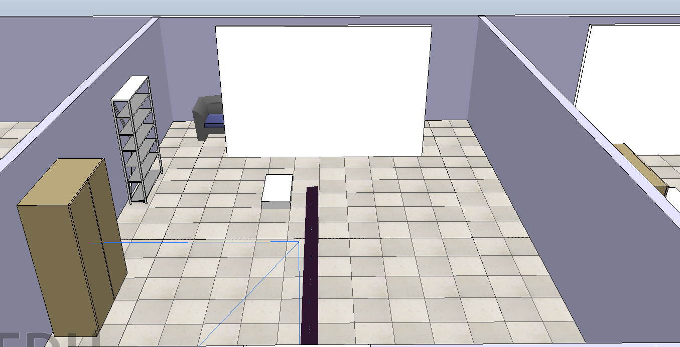
Simulation Environment
Hospital Cabin Inside View

Slide 7
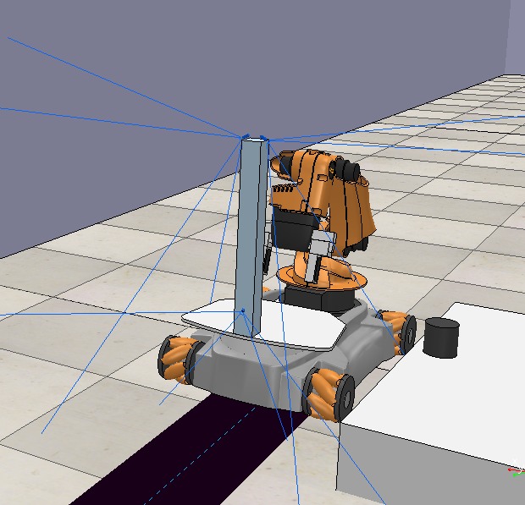
Robot Model
Robot (KUKA Youbot)

Slide 8
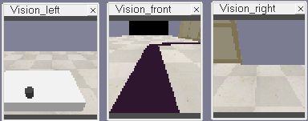
Robot Model
Vision sensor in 3 directions

Slide 9
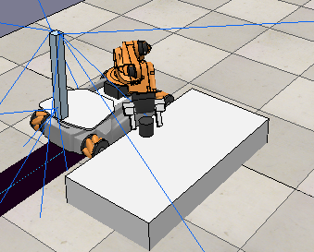
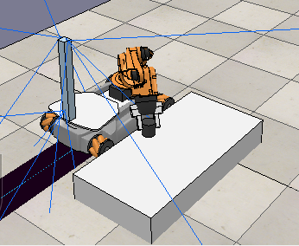
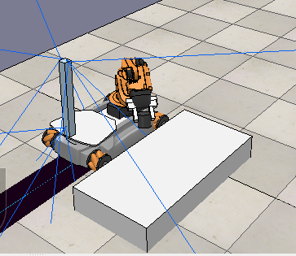
Manipulator Operation
Robot Picking the Object

Slide 10
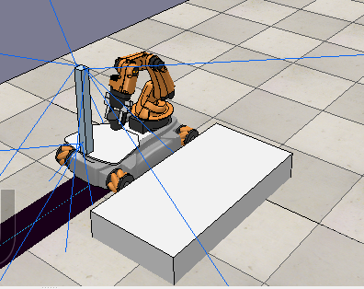
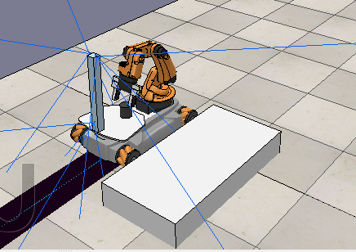
Manipulator Operation
Placing Object in its Carrier to carry to the Patient Room

Slide 11
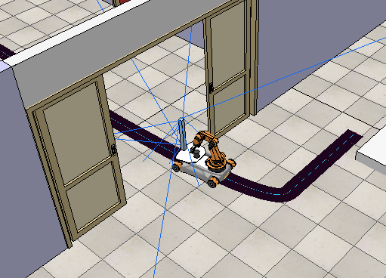
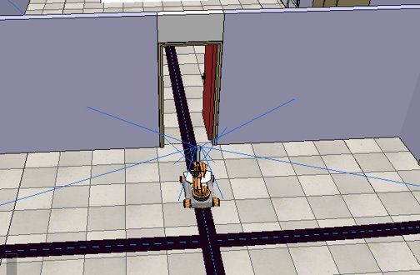
Mobile Robot Operation
Exiting the service room
Entering patient cabin

Slide 12
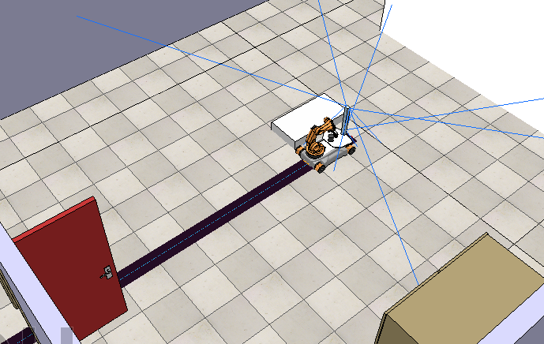
Mobile Robot Operation
Mobile robot stopped after reaching destination

Slide 13
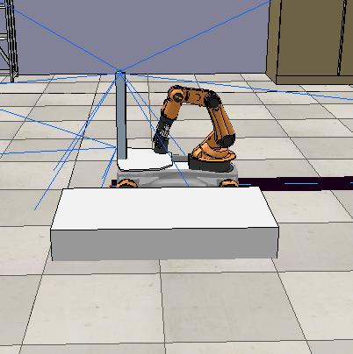
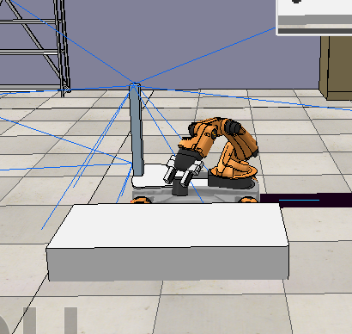
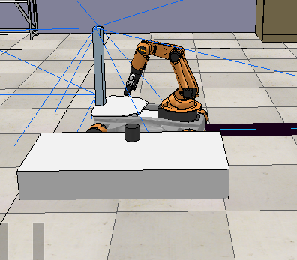
Manipulator Operation
Bot Placing Object on the Room Table

Slide 14
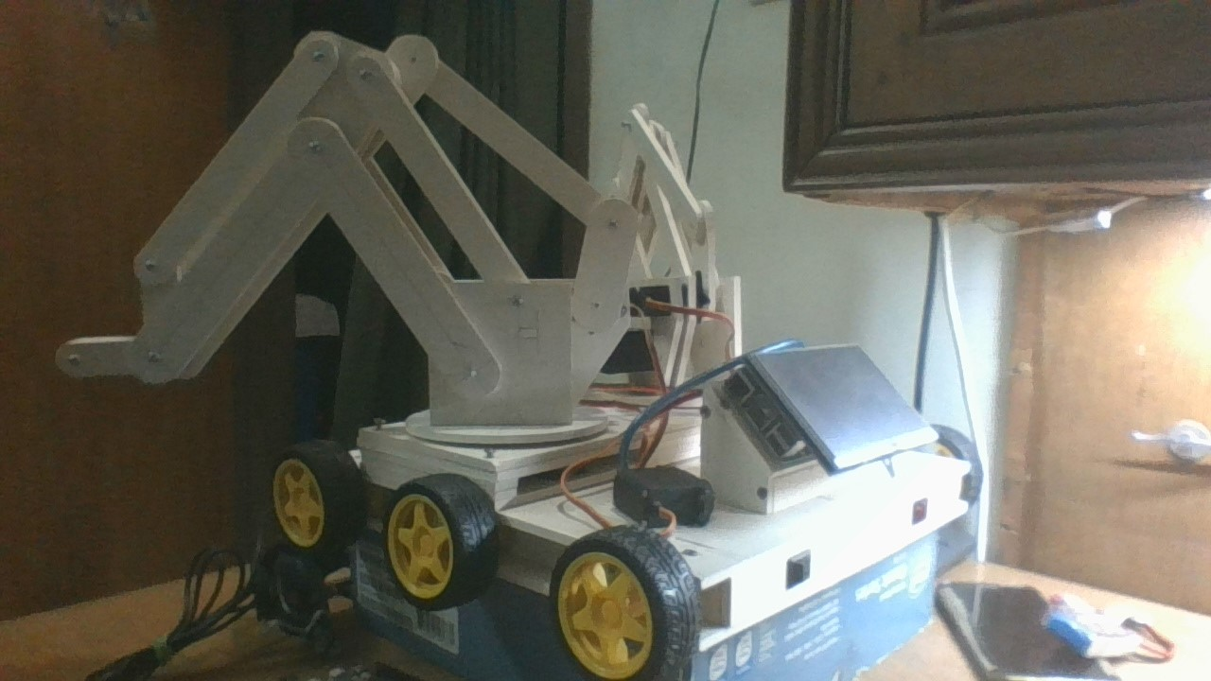
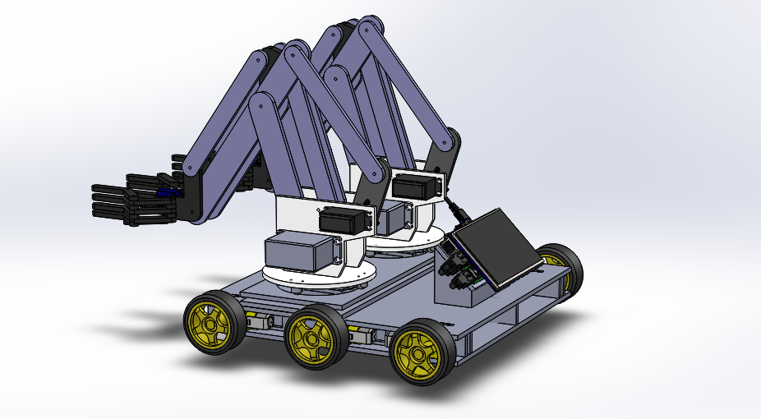
Robot Model
Original hardware prototype
Solidworks model

Slide 15
Robot Model
Proposed Components List
Components | Cost (BDT)
30kg Servo x 4 | 8000
15kg Servo x 2 | 2000
90g Servo x 4 | 1000
Encoder Motor + Wheel x6 | 9000
Raspberry Pi | 4000
Raspberry Pi Display | 3500
Webcam x 3 | 9000
Acrylic body + laser cut | (undetermined)
Solidworks model

Slide 16
Individual Contributions
Name | Student ID | Contributions
Himaddri Roy | 1606002 | Setup of remote API connection with MATLAB and handle the scene objects through MATLAB script Implemented Door Logic(Open/Close) Control
Mir Sayeed Mohammad | 1606003 | Forward and inverse kinematic solver(using Jacobian of forward kinematics) for manipulator Motion planning for object pickup and placement.
Ramit Dutta | 1606006 | Selection of appropriate robot model and sensors Design the virtual hospital model with proper infrastructure and furniture and the LFR path
Shafin Bin Hamid | 1606008 | Implemented control logic for Line-follower Synchronized line follower routine with core routine
Munshi Sanowar Raihan | 1606021 | Image thresholding to identify the delivery object from vision input. Apply perspective transform to correctly localize the object in the 3d environment.

